Slide 1
Machine Learning – RIME 832 Over fitting Problem and Regularization

Slide 2
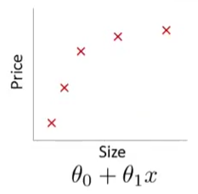
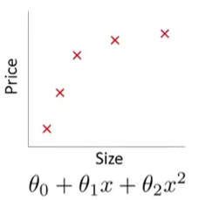
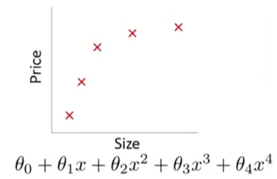
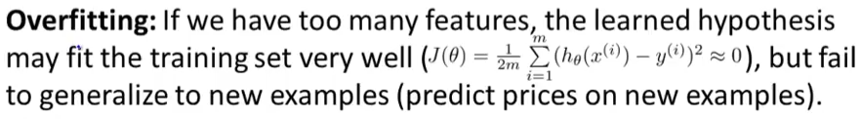
Example: Linear Regression
Under fit
High bias
i.e. prices of houses will vary linearly
Over fit
High variance
i.e. The space of high order polynomial hypothesis is too large and variable and can fit anything.
Just Right

Slide 3
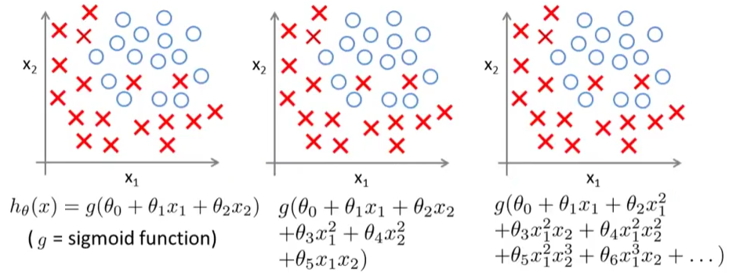
Example: Logistic Regression
Under Fitting
Reasonable
Over Fitting

Slide 4






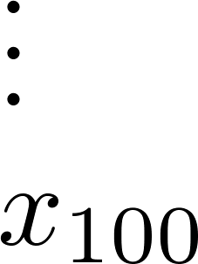
Addressing overfitting:
size of house
no. of bedrooms
no. of floors
age of house
average income in neighborhood
kitchen size

Slide 5
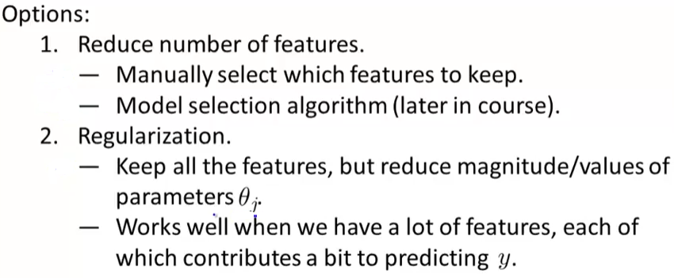
Solution

Slide 6

Regularization
Suppose we penalize and make θ₃ and θ₄ very small
+ 1000 θ₃²
+ 1000 θ₄²
θ₃ = 0 and θ₄ = 0

Slide 7
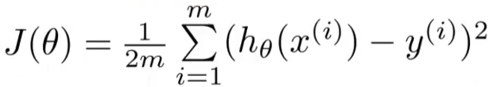

Regularization
Small values of parameters θ₁, θ_{2 ,}θ₃,…….., θ_{n}
Simpler hypothesis
Less prone to over fitting
Housing:
Features: x1, x2, …….., X100
Parameters: θ₁, θ_{2 ,}θ₃,…….., θ₁₀₀
Out of 100, it is hard to pick the ones, which are less likely to be relevant?
+

Slide 8
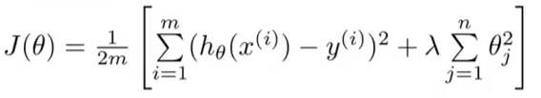
Regularization
Lambda is the regularization parameter, and controls the tradeoff between our goals
Fit well to the training data
Keeping the parameters small
The two goals result in simple hypothesis and therefore less chances of over fitting

Slide 9
Regularization
- Not Regularized
- Regularized

Slide 10
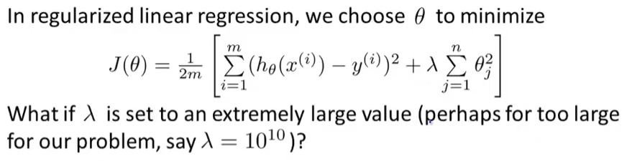
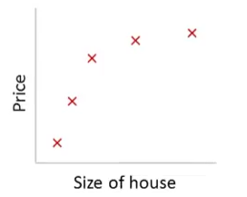
Regularization
Under fitting
High bias
Zero
h_{θ}(x) = θ₀ + θ₁x + θ₂x² + θ₃x³ + θ₄x⁴

Slide 11
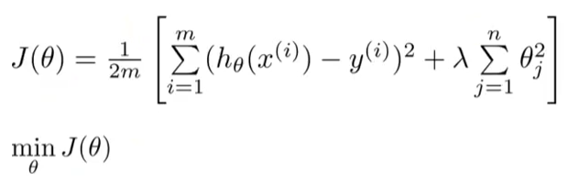
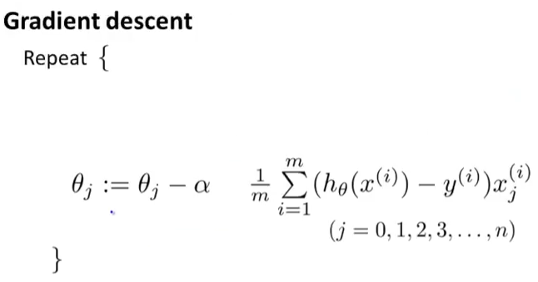
Regularized Linear Regression

Slide 12
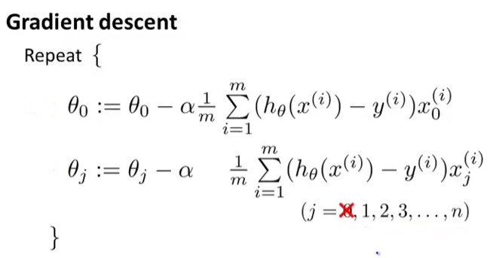
Regularized Linear Regression
Since we do not penalize θ₀, let’s take it out

Slide 13


Regularized Linear Regression
[
]
Shrinks the parameter
Original gradient descent update

Slide 14
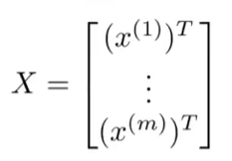
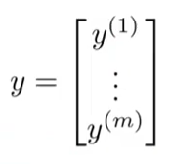

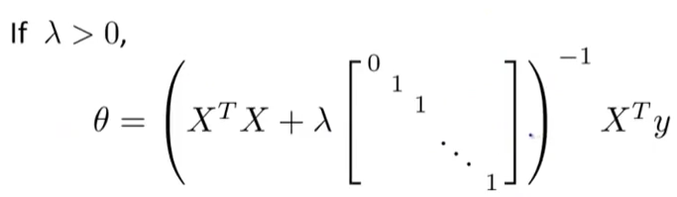
Regularized Linear Regression
Normal Equations
Without Regularization
With Regularization

Slide 15
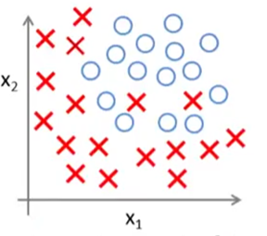
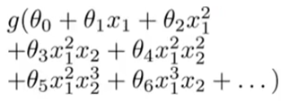


Regularized Logistic Regression
Original/Without Regularization Cost function:
With Regularization Cost function:

Slide 16
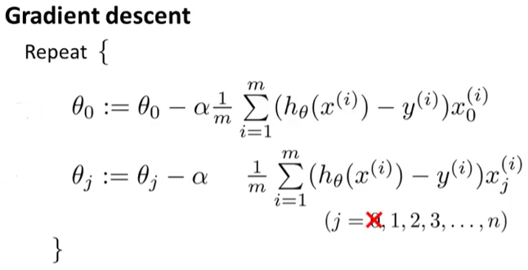


Regularized Logistic Regression
Looks similar but not the same since hypothesis is different
[
]

